Slide 1

Remote Timer Job Framework
Anders Dissing
CTO
Procurati

Slide 2
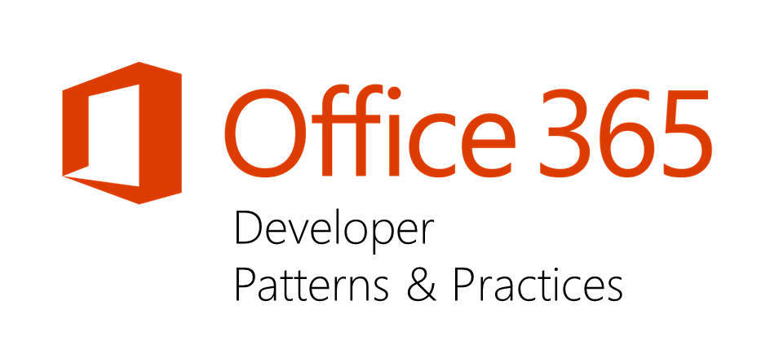


Sharing is caring…
Code samples
Guidance documentation
Monthly community calls
Case Studies
Themes
SharePoint add-ins
Microsoft Graph, Office 365 APIs etc.
Remote provisioning
Client side development
http://aka.ms/OfficeDevPnP

Slide 3
Agenda slide
Introduction to remote operations in SharePoint
PnP to the rescue: the remote timer job framework
Demo
Using Azure as the platform to host your remote operations
HOL

Slide 4
1
Introduction to remote operations in SharePoint

Slide 5
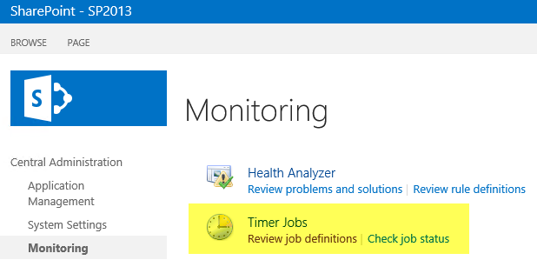
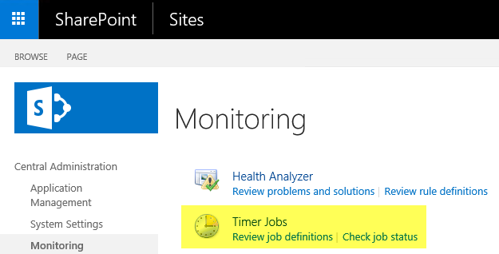
How did we do this…or still do?
public class MyTimerJob : SPJobDefinition
Notes:
Historien om timerjob og at der køre som full trust kode.
Hvad er der af muligheder for at ændre dette?
OOTB timerjobs
Custom timerjobs

Slide 6
Remote timer job architecture
Scheduled execution which accesses the needed resources from the SharePoint service and performs the required automation.
Can use either specific account for connection or oAuth based app-only token approach
SharePoint Service
2
Provider Hosted Apps
1
Remote timer job
Notes:
Hvordan virker PnP timerjobs

Slide 7
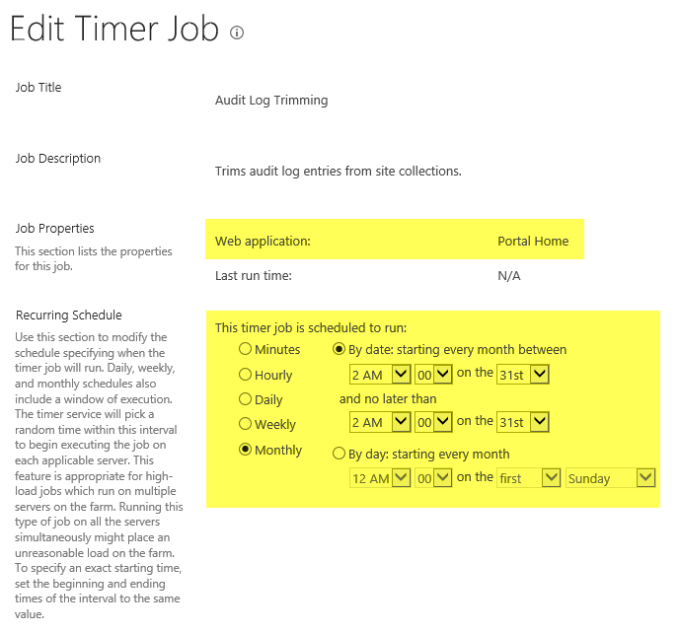
Anatomy of a timer job in SharePoint On-premises
Scope = What sites to run against?
Schedule = When to run?
Host = Where to run?
Authentication = Who’s running it?

Slide 8
“Remote” timer jobs components
Scope
Schedule
Host
Authentication
Timer jobs
Web Application
Farm
Via Central Administration
SharePoint server
Farm account
“Remote” timer jobs
(Wildcard) Site collection scope
Azure Web jobs
Windows Scheduler
Azure
Windows server
Credentials
App-Only
Notes:
SPJobs kan være meget farlige ved forkert JobType, fx hvis den sættes til per ContentDB.

Slide 9
Business scenarios
Governance related tasks
Maintenance tasks
Fall back scenario for business logic depending on remote event receivers
Notes:
Remote event receivers er fire and forget (ingen garanti for levering af eventen)

Slide 10
“Performance of code running outside of the SharePoint is lower than server side…”
Correct.
There’s already hundreds of timer jobs running native in the SharePoint, is placing your code among those really the only option compared to adding the code to clean platform?
Notes:
Ved at bruge PnP timerjob har man mulighed for at scalere dem. Det har man ikke på samme måde i SharePoint.
Generelt er CSOM hurtigere end SSOM: https://soerennielsen.wordpress.com/2013/08/25/use-csom-from-powershell/

Slide 11
2
PnP to the rescue: the remote timer job framework

Slide 12
Getting started
1
NuGet
2
TimerJob
3
4
5
Deploy and Run
PnP Core Component
MyJob
Notes:
Tilføj PnP package
Nedarv fra den rigtig klasse
Lav service account eller app-only token kalde. Med en eller anden form for rettigheder skal vi havde på plads.
”Lav” liste af sitecollections, som timerjobet skal køre på
Kør timerjob

Slide 13

DEMO: “Hello world” remote timer job
Notes:
Trin i Program.cs:
Instans af Job
Sæt authentication
AddSite()
Run()
Vis også:
- Wildcard in site URL
Multithreading
MaxThreads
ExpandSubsites

Slide 14
The PnP TimerJob framework benefits
Configuration of authentication
Dynamic scope (=sites to operate on)
Runs at site level and optionally at sub site level
Configurable multi-threaded execution model
Optional state management
Easy development experience
Logging

Slide 15
Authentication
Use specific account
Similar as classic service account model in on-premises
Use specific account for accessing Office 365 which has required license and permissions to needed services
User identity and password has to be stored in the location where code is executed
App-Only token
Register app id and secret, which is used by the remote timer job to access Office 365
Set app id and secret for the remote timer job in app config or using other means
Tokens can be revoked in the server side
Not all functionalities work with app only tokens
Notes:
Ikke alle features er tilgængeligt med app-only, fx dynamic scope!

Slide 16
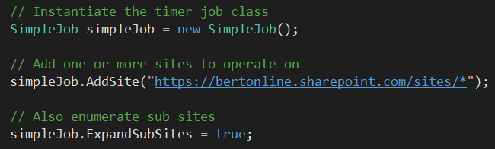
Dynamic scope
TimerJob class
Properties:
ExpandSubSites
Methods:
AddSite(string site)
ClearAddedSites
When using App-Only authentication this requires “enumeration” credentials to be set
Notes:
Det virker ikke som udgangspunkt med app-only. Der skal man så tilføje en enumeration account, som finder de sites der skal benyttes.

Slide 17
Authentication
Credentials or App-Only?
Credentials
App-only
Office 365 or On-Premises?
Office 365 or On-Premises?
Office 365
Office 365 + On-Premises
UseAzureADAppOnly Authentication
UseAppOnly Authentication
Office 365
On-Premises
UseOffice365 Authentication
UseNetworkCredentials Authentication
Wild card site urls used?
Yes
SetEnumeration Credentials

Slide 18
DEMO: Real world remote timer job
Notes:
Core.TimerJobs.Samples, Sample 5 – GovernanceJob (https://github.com/OfficeDev/PnP/tree/master/Solutions/Core.TimerJobs.Samples)

Slide 19
3
Using Azure as the platform to host your remote operations

Slide 20
Hosting your “remote” timer jobs
SharePoint 2013/2016 on-premises
SharePoint Online
Option 1:
Deploy .exe and run using built-in Windows Scheduler service
Option 1:
Deploy as web job to an Azure Web site or
as Azure function with timer trigger
Option 2:
Build own scheduler NT service that runs the jobs
Option 2:
Use one of the on-premises deployment options

Slide 21
DEMO: Deploying to Azure

Slide 22
Remote timer job for async tasks
Why
Ensure that end user operations are fast, but start still long lasting operations as needed
What
User remote timer jobs also for one time asynchronous operations
How
Spin up remote timer job queues for process. Exact model depends on used technology, but storage queues and web jobs are excellent model for Azure based app model implementation

Slide 23
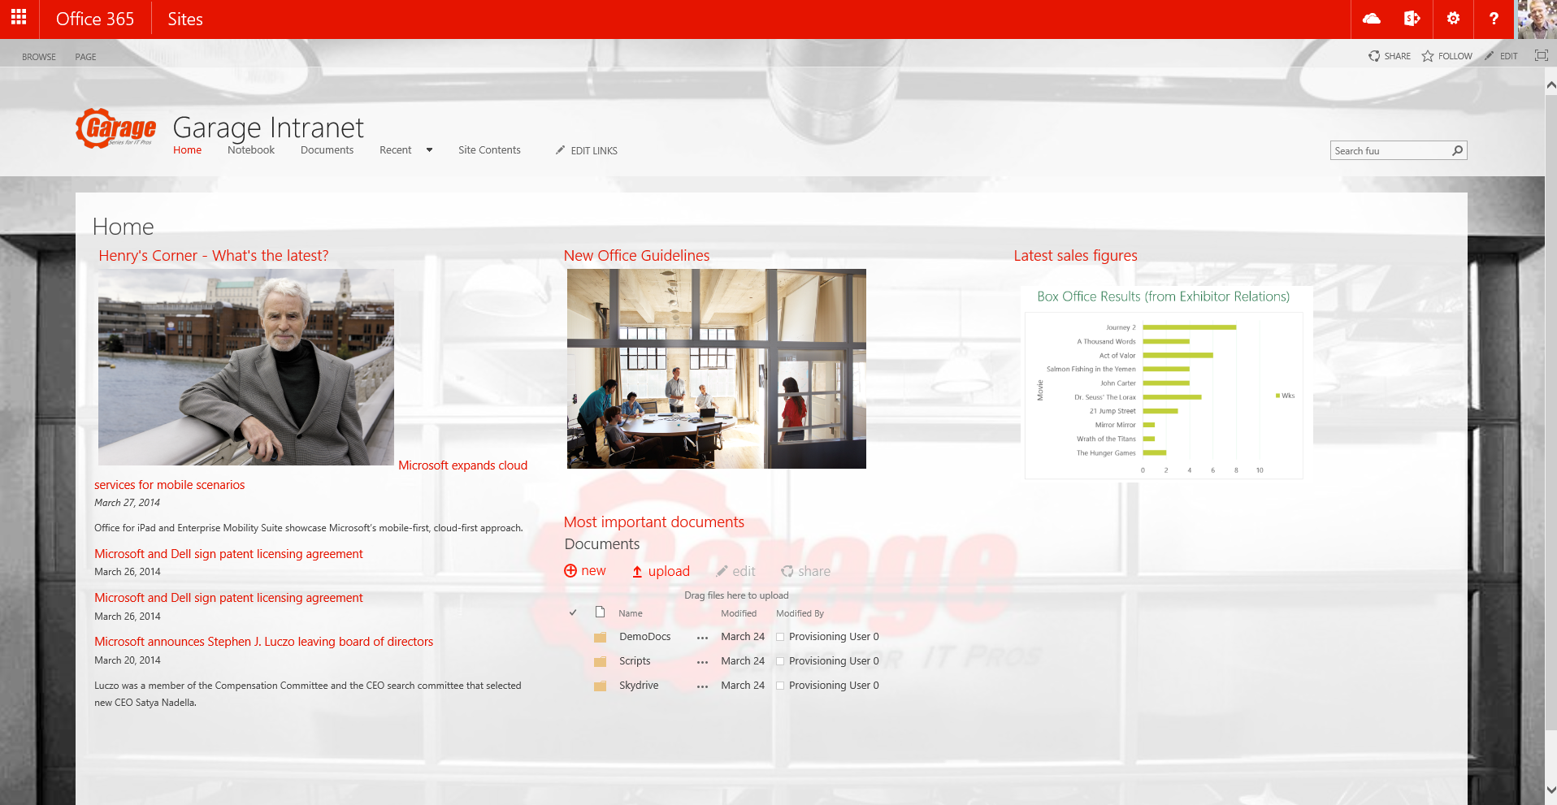
Asynchronous pattern with Azure web jobs
Provider Hosted Apps
2
SharePoint
<<Run app functionality>>
<<Add message>>
1
Storage Queue
3
<< Perform needed actions>>
<<instantiate>>
WebJob
4

Slide 24
HOL: Site Governance Timerjob

Slide 25
Resources
Timer Job framework:
https://github.com/OfficeDev/PnP-Sites-Core/blob/master/Core/TimerJob%20Framework.md
Samples using the timer job framework:
https://github.com/OfficeDev/PnP/tree/master/Solutions/Core.TimerJobs.Samples
https://github.com/OfficeDev/PnP/tree/master/Solutions/Governance.TimerJobs

Slide 26
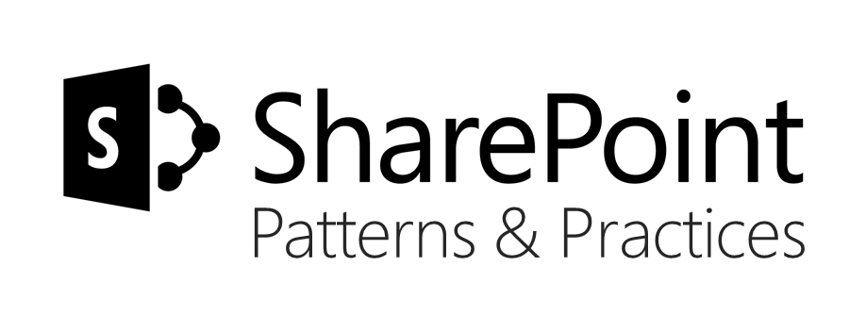







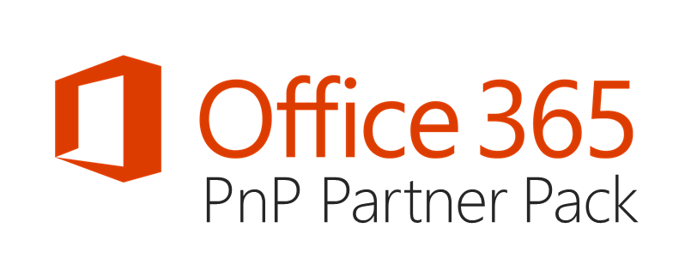

aka.ms/OfficeDevPnP
https://github.com/OfficeDev/PnP
https://github.com/OfficeDev/PnP-Sites-Core
https://github.com/OfficeDev/PnP-PowerShell
https://github.com/OfficeDev/PnP-Tools
https://github.com/OfficeDev/PnP-Guidance
https://github.com/OfficeDev/PnP-Transformation
https://github.com/OfficeDev/PnP-OfficeAddIns
https://github.com/OfficeDev/PnP-Provisioning-Schema
https://aka.ms/OfficeDevPnPVideos
https://aka.ms/OfficeDevPnPMSDN
https://aka.ms/OfficeDevPnPYammer
https://docs.com/OfficeDevPnP
@OfficeDevPnP
https://aka.ms/OfficeDevPnPCall
https://aka.ms/OfficeDevPnPPartnerPack

Slide 27
Q&A

